Slide 1
The School-Day SAT®
Initiative:
Creating Access and Opportunities for all Students
Notes:
We are a not-for-profit membership organization
More than 850 districts, high schools and colleges
We are committed to the principle that all students deserve an opportunity to participate in rigorous, academically challenging courses and programs

Slide 2
WCCUSD Overview - Progress to Date 8-year Timeline
2007 1) Initial PSAT/NMSQT® Partnership 2) My College QuickStart™ Access 3) Advanced Placement Incentive Program (APIP) Grant Winner
2011 ReadiStep™ for 8th Graders
2013 1) SAT® School Day 2) SAT Online Course Access 3) AP STEM Courses
Notes:
Arrow with seven texts

Slide 3
Agenda
College Board Partnership
SAT School Day Overview
SAT School Day Support
Resources for Schools, Students, and Families
Timeline
Next Steps
Questions
Notes:
Fact -The rigor of the curriculum is the most significant predictor of academic success and post secondary education completion.

Slide 4
Creating a District wide Culture of College and Career Readiness
How can an assessment build a college and Career Readiness Culture?
Part of a strategy of setting higher expectations – Developing a post-secondary readiness model.
Develop a plan to thoroughly integrate college and career readiness into the framework of the academic system.
Creating opportunities for students who are uncertain or do not believe post-secondary education is an option for them.
The SAT has to be more than just a test.

Slide 5
Providing College and Career Opportunities for ALL Students
SAT School Day Provides:
•A familiar experience for students who traditionally may not participate.
•Connect traditionally under-represented students to colleges and universities. Students will be better prepared for success at the post-secondary level.
•Remove barriers to access/success –Transportation, Time, Exam Anxiety.
•Prepare students for the road ahead -Tools, Support, Financial Aid, and Connections to Post-Secondary Education.

Slide 6
PSAT/NMSQT Participation Growth
+141.6% Increase since the Commencement of the Partnership in 2007
Notes:
Participation – by year

Slide 7
PSAT/NMSQT Participation Growth by Ethnicity
Percentage of Participation Increase since commencement of the partnership in 2007:
+154% Increase in Black or African American Participation
+190% Increase in Mexican or Mexican American, Other Hispanic, Latino, or Latin American Participation
+135% Increase in White Participation
Notes:
Participation – by ethnicity

Slide 8
SAT Performance Growth – Class of 2012
Average mean scores of WCCUSD students who took the PSAT was more than 94 points higher than the test takers not participating in PSAT/NMSQT as a junior, sophomore, or younger.
Notes:
SAT 2012 graduation class

Slide 9
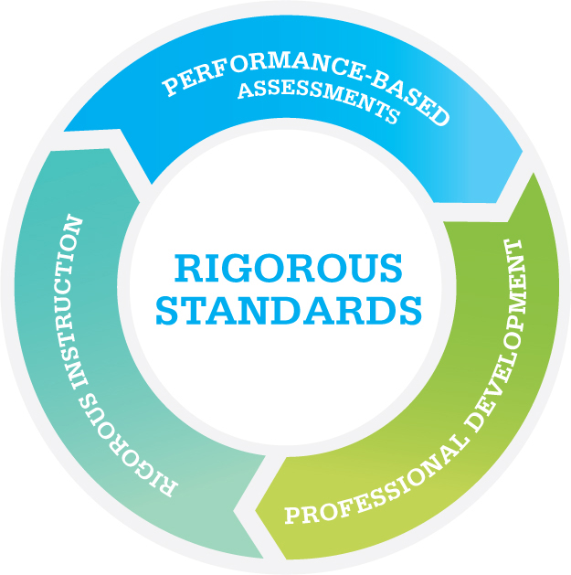
SAT® School-Day
Removing barriers to provide equity in access:
Transportation
Location
Preparation
Builds a culture of opportunities for students
Logical follow up to PSAT testing
Comprehensive Assessment System for the district to monitor progress 8-12
Notes:
BENEFIT: Students felt more rested in the middle of the week and less stressed over transportation and testing logistics.
BENEFIT: Parent and teacher feedback was also overwhelmingly positive.
UNEXPECTED BENEFIT: Athletic director and coaches were thrilled with mandatory testing and some early eye-opening results, especially since SAT or ACT test scores are required before an “official visit” to a NCAA Division I or II college.

Slide 10
Benefits of SATSD to Colleges and Universities
Colleges and universities benefit from:
An increased and diversified pool of college-ready students to help achieve their enrollment goals
More student names available in Student Search Service
More prospective students one step closer to completing their college applications

Slide 11
Sample Data Reports
Notes:
SWH– Insert slide of the types of reports schools receive from administration—
SOAS Reports, SAT School Day Reports

Slide 12
Other Districts Participating in SATSD
Miami-Dade County Public Schools
Houston Independent School District
Hillsborough County Public Schools
Baltimore County School District
Seattle Public Schools
Dallas Independent School District
Fort Worth Independent School District
Palm Beach School District
Federal Way Public Schools (outside of Seattle)

Slide 13
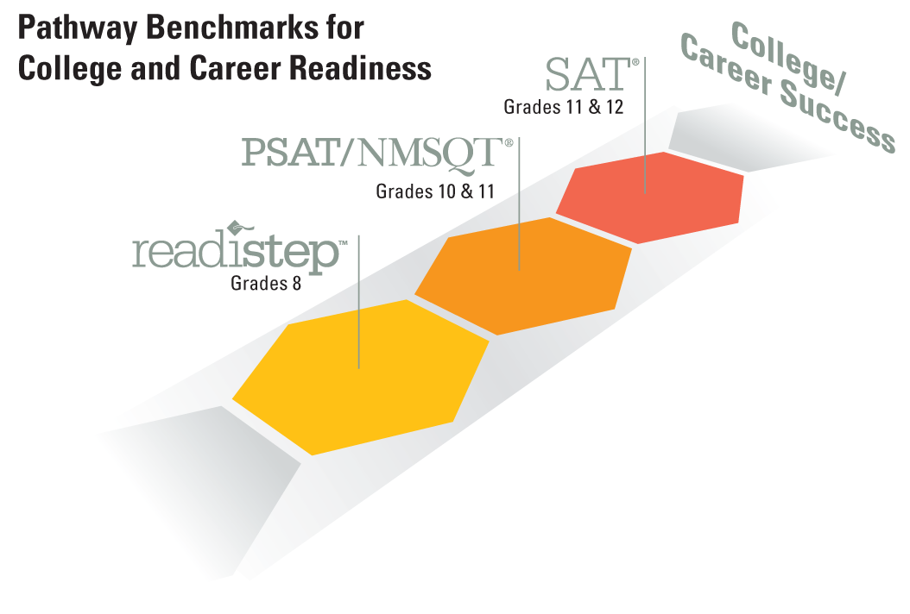
WCCUSD College and Career Readiness Day
District wide Assessments Grades 8-12
October 16, 2013
SAT® School Day offered to grade 12
PSAT/NMSQT® offered to grades 9th – 11th
ReadiStep™ offered to 8th graders
College and Career Readiness Activities conducted in grades 7-K

Slide 14
Phase I: Planning
Each high school site becomes an SAT Test Center with key staff roles
Test center supervisor,
Alternate test center supervisor,
Services for Students with Disabilities (SSD) coordinator,
Student registration coordinator,
Online course coordinator, and
A data/technology liaison.
Notes:
SATSD Program has launched communication to the identified leader for the key roles.

Slide 15
Planning Resources

Slide 16
Phase IIA: Student Registration
Student registers online for the SAT School Day administration
Each school site will receive a supply of vouchers
Students need an email address and College Board account
Access to SAT Online course for full academic year
Student will print out registration admission ticket
Online monitoring of SAT registration
Notes:
In-School Registration Expected Outcomes
100% of senior class opened or update College Board / SAT account and 100% pre-register for School-Day SAT test.
BENEFIT: Reduced stress levels among students and ―helicopter‖ parents. Assisted students with ―absent‖ parents.
UNEXPECTED BENEFIT: Can compare SAT registration roster with school’s enrollment roster to identify differences / problems in spelling of legal name (5%).

Slide 17
Student Preparation
Access to the Official SAT Online Course
18 interactive lessons
10 complete practice tests
More than 600 practice questions
Study Guide/Online course
Practice essay scoring service
Free website practice links
http://sat.collegeboard.org/practice/sat-practice-test
http://sat.collegeboard.org/practice/sat-practice-questions
Notes:
Unpacking

Slide 18
The Official SAT Online Course™
All participating Seniors receive full access for one year
One access code per school
College Board support and resources:
Online training session for educators
12-module educator’s guide to facilitate student use of the Online Course
Comprehensive communications plan to students, parents and educators
Collateral materials for schools (flyers, letters, etc.)
Online Course Coordinators identified during test center intake process
Welcome Kits with access instructions will be delivered in late August

Slide 19
SAT Resource Tools

Slide 20
Resources of Parents and Community Members
Fact Sheets in English and Spanish for Parents
SAT Question of the Day
Big Future

Slide 21
WCCUSD SAT School Day Professional Development and Support
District Leadership SATSD Roll-Out Webinar – August 22nd
Preparing for the PSAT/NMSQT Administration – September 19th
Preparing for the ReadiStep Administration – September 12th
SATSD Test Center Supervisor Online Training Available – SAT Registration Window
Tentative:
SATSD Test Center Supervisor Online Follow-Up mid September
SATSD District-to-District Sharing of Best Practices early September

Slide 22
SAT School Day Resources
Webinars
SAT School Day Toolkit Best Practices
SAT Supervisors’ Manual
A Guide for SAT School Day Staff
Online resources

Slide 23
School Site Plans
Plan a team meeting with key staff members to determine roll out plan
Determine and discuss testing needs
Identify the number of rooms and proctors
Schedules: Start time 8:00 am
Late comers
Lunch schedules
Facilities
Communication
Registration encouragement
Notes:
Instruct participating teachers to pick up and return test materials from Guidance Office / command center.
Allocate five (5) hours for test administration.
Address lunch issues for participating teachers and extended-time test-takers, and snack issues for test-takers.
Test security Test Center Supervisors complete online training, then plan staff / teacher training.
Secure test materials and testing rooms.
Arrange for special test accommodations.
Cancel bells and limit movement.
May use Guidance Office as command center. Communicate by email with room supervisors and by cell phone with hall proctors.

Slide 24
Summary of Key Milestones
2013
Test Center setup completed Mid August
Applications for students requiring accommodations can begin anytime and are due by August 28th
Student registration window opens September 4th and closes October 2nd
Test center supervisor training begins September 4th and ends October 2nd (aligns with student registration window)
Test administration October 16th
Notes:
Online Course access provided (within 40 days after receipt of Test Center Intake form) - will be sent after contract is executed

Slide 25
IMPLEMENTATION MILESTONES – Fall 2013
ACTIVITIES | MAY | JUNE | JULY | AUGUST | SEPTEMBER | OCTOBER | NOVEMBER
Set up SAT Test Centers
SAT Communications Campaign
SAT Practice Tools – Delivery and Usage
Application for Accommodations for Students with Disabilities
Registration Activities
Training Designated Personnel
SAT Test-Day
Post-Test Support
Data and Reporting
Aug 2
Delivery
Student use
Aug 28
Sep 4
Oct 2
Sep 4
Oct 2
October 16, 2013

Slide 26
Thank You!
Sandra Williams Hamp
Office: 408-367-1425
Email: swilliams-hamp@collegeboard.org
Additional resources:
http://professionals.collegeboard.com/higher-ed/recruitment/sat-test/school-day

